Slide 1
Removing “Crapware” from a new PC
Dennis Smith – CAMUG
September 21, 2020

Slide 2
Agenda
It should be clean – right out of the box
But why isn’t it?
Utilities to use
Steps to take
But if this is really a new PC…
Just a a few more steps…

Slide 3
It should be clean – right out of the box
You bought a brand new PC or Laptop
You connect up all of the components
You turn it on
You expect a clean system
After all, you haven’t installed anything on it yet

Slide 4
But why isn’t it?
After all, you haven’t installed anything on it yet
But the manufacturer has!
Why?
They are paid to install that junk for you – by the software vendors
It helps them offset the fact that PC prices have been steadily dropping
The vendors want you to see their software and get accustomed to using their trial versions
They want you to buy the full version ($$)

Slide 5
But why isn’t it?
Even Microsoft sometimes puts some “crapware” on your PC
I have seen:
Candy Crush Friends Saga
Candy Crush Saga
Candy Crush Soda Saga
Cooking Fever
March of Empires: War of Lords

Slide 6
But why isn’t it?
Even Microsoft sometimes puts some “crapware” on your PC
On an HP Laptop that I ran a reset on earlier this month:
Wild Tangent Games
McAfee LiveSafe
Amazon
Dropbox Promotion
Netflix
Office
Priceline
HP Jumpstart Apps
HP Jumpstart Bridge
HP Jumpstart Launch
HP Jumpstart
HP System Event Utility

Slide 7
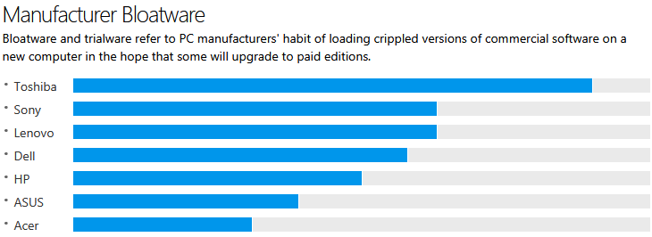
But why isn’t it?

Slide 8
But why isn’t it?
Crapware – Bloatware – Shovelware
Whatever you call it, you almost certainly don’t want it
It is possible that they might even contain malware or viruses
Sometimes, they are labeled as PUPs (Potentially Unwanted Programs)
And, they take up disk space, memory, and slow down your PC

Slide 9
Utilities to use
Start > Settings > Windows Apps to uninstall each item
SlimCleaner ($19.97/yr. 1 PC, $39.97 2 PCs 2 yrs., $59.97 lifetime 5 PCs)
Should I Remove It? Free – Removes many PUPs
PC Decrapifier (no longer available) – bought by Avast - now included in $119.99/year Avast Ultimate product)
CCleaner – “The world's most popular PC cleaner”
Malwarebytes – Removes malware, but not crapware
Revo Uninstaller – Choose what to uninstall, then click “Uninstall” Moderate or Advanced mode is recommended
AdwCleaner – Click “Scan”, then “Clean” to remove PUPs Utility names are clickable links!

Slide 10
Steps to take
Download the utility
Note that this might need to be performed on another PC and transferred to the new PC because sometimes the offending software interferes with your browser
Run the utility
Be careful not to remove anything other than the junk
Removing essential Windows components can prevent your PC from booting!
Don’t forget to reactivate Windows Defender if you uninstall the active Antivirus program, such as a trial of Norton

Slide 11
But if this is really a new PC…
Use the Windows 10 Fresh Start Tool or Reset Your PC Tool
Do not use an image provided by the PC manufacturer – it probably contains the crapware!
Starting at Windows 10 version 1909, this can be installed straight from the Web, and does not require separate installation media (USB drive or CD/DVD)
This will give you a CLEAN INSTALL of the latest version of Windows 10
Note: This may not be the same version that you already have installed
Sometimes this installs other crapware (mine did on an HP laptop) that needs removed
Now, you are ready to install the software that YOU want to use

Slide 12
But if this is really a new PC…
Windows 10 before 2004: The Windows 10 Fresh Start Tool:
Note: Fresh Start doesn’t delete the files and folders stored on your computer. Still, it’s recommended to backup all your data before doing anything.
Open the Start Menu > Search for Windows Security.
Go to Device performance & health page.
Under Fresh Start, click the Additional Info link.
Click on Get Started and accept the UAC prompt
Click on Next, then review the list, and click Start to begin the process.

Slide 13
But if this is really a new PC…
Windows 10 2004 and beyond: The Windows 10 Reset This PC Tool:
Note: Reset This PC doesn’t delete the files and folders stored on your computer. Still, it’s recommended to backup all your data before doing anything.
Go to Start > Settings > Update and Security
Click on Recovery > Reset this PC
Click on Get Started then select Keep my files (or you get to reinstall everything)
Select Cloud or Local, change your settings, and set Restore Preinstalled Apps to No (if you don’t see this, then there are no preinstalled junk on your PC)

Slide 14
Just a few more steps…
Now, install your desired software
Start with Malware and Antivirus, if you decide not to use Windows Defender
Be careful not to install crapware again (use Ninite.com whenever possible)
Watch out for checkboxes when installing
You don’t want extra toolbars and other stuff clogging your system again
Run Windows Update until there is nothing new to update
Backup the freshly setup machine
Keep this backup separate from your normal incremental backups (use a special name)
This will be easier than reinstalling the software again later

