Slide 1
Several Interesting Windows 10 Tips
CAMUG 1/18/2021

Slide 2
Main Topics
Windows 10 Settings to Change
12 Simple Tweaks to Speed Up Windows 10
Windows 10 Free Fix Tools
Finding the old SYSTEM panel
Windows 10 Power Tools
Windows 10 on a Bootable USB
Windows 10 Registry Backups
The basis for all of these items came from various PC Magazine articles

Slide 3
Main Topics
Windows 10 Settings to Change
12 Simple Tweaks to Speed Up Windows 10
Windows 10 Free Fix Tools
Finding the old SYSTEM panel
Windows 10 Power Tools
Windows 10 on a Bootable USB
Windows 10 Registry Backups
The basis for all of these items came from various PC Magazine articles

Slide 4
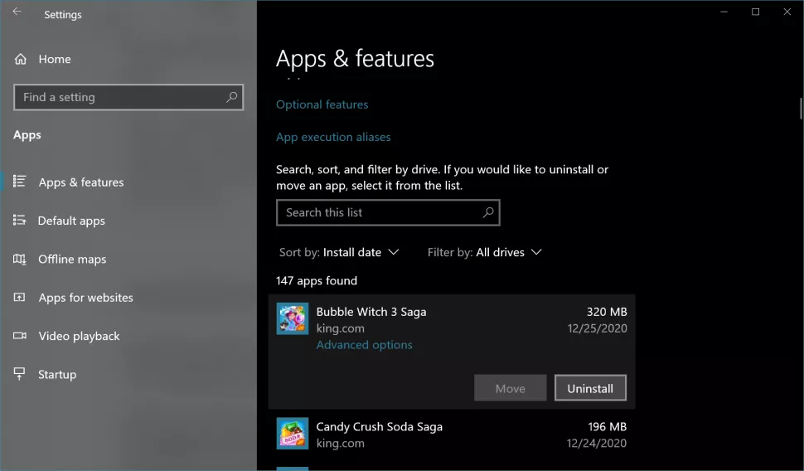
Windows 10 Settings to Change
Uninstall the Crapware
Notes:
No matter what vendor you buy your PC from, it is almost certain to come loaded with free-to-play games, antivirus trialware and other software you don’t need or want. Sadly, a lot of that stuff is actually shoveled on by Microsoft itself, rather than the OEM.
While most of the preloaded crapware is harmless and barely takes up any disk space, some of it is going to drain system resources and nag you to buy something (like a full subscription to antivirus software when you can use Windows 10’s built-in, free antivirus).
To get rid of crapware, search for “add or remove” in the Windows search box, click-through to the menu and go through the list of applications. We recommend keeping anything you’re not sure about and leaving OEM utilities in place, just in case you need them.
This was the topic of a previous meeting (September 19).

Slide 5
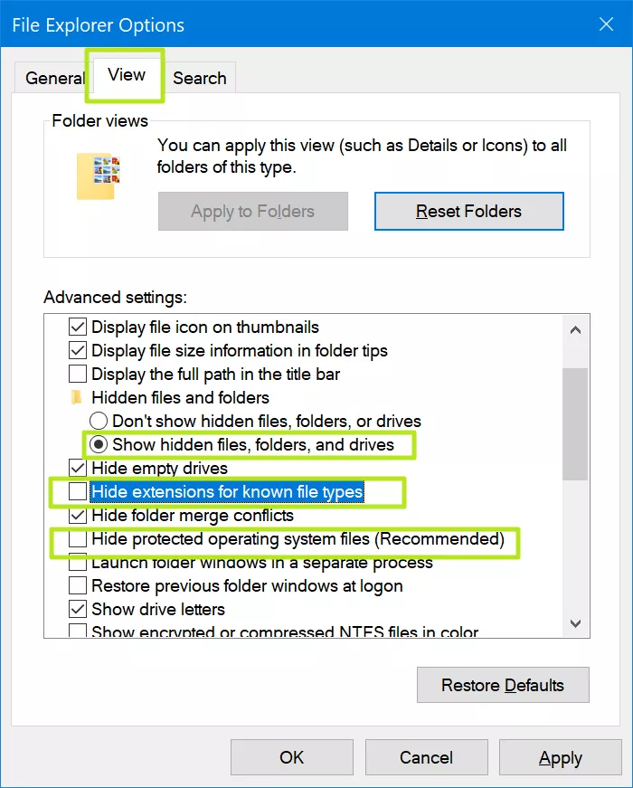
Windows 10 Settings to Change
Unhide File Extensions and Hidden Files
Notes:
Clearly, Microsoft thinks that file extensions are too complicated for the unwashed masses. So, by default, Windows 10 hides the ".docx" or ".jpg" or ".exe" suffixes that appear at the end of file names. This way, when you get a spreadsheet from a friend, File Explorer will show that it's a "Microsoft Excel Worksheet" whether it's an Excel 2003 .xls file or a modern-day .xlsx file. Good luck with that!
To make file extensions visible again, enter "file explorer options" in the Windows search box, select the View tab, and then uncheck "Hide Extensions for Known File Types."
While you're at it, you might want to toggle "Show hidden files, folders and drives" to on and uncheck “hide protected operating system files” so you can see all your system files.

Slide 6
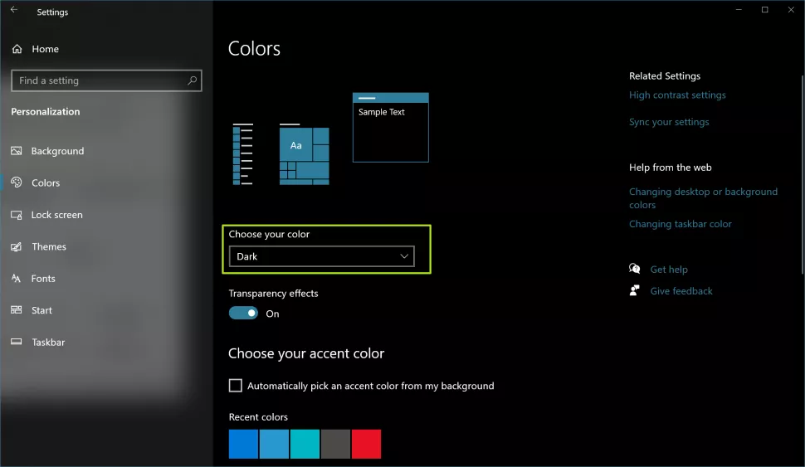
Windows 10 Settings to Change
Enable Dark Mode
Notes:
Many users prefer dark text on a light background. By default, all of Windows 10's menus are in light mode with black text on white.
However, you can enter Dark Mode by navigating to Settings->Personalization->Colors and selecting Dark under the "choose your color" header.

Slide 7
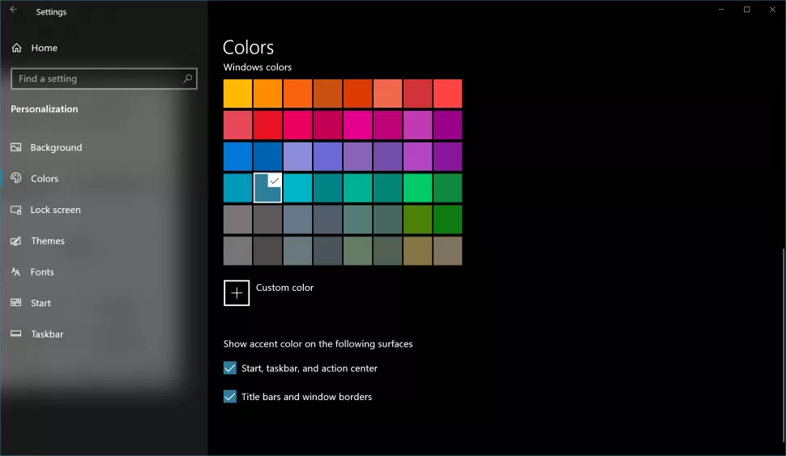
Windows 10 Settings to Change
Change the Title Bar Colors
Notes:
While you’re enabling Dark Mode (if you are), here’s something else to do. Windows 10's default title bar color is a bland white, which is not only boring, but kind of hard to look at. Fortunately, it's easy to assign an accent color to title bars, the Start Menu and the taskbar.
Navigate to Settings->Personalization->Colors, pick a color and check the boxes next to "Start, taskbar and action center" and "Title bars and window borders."

Slide 8
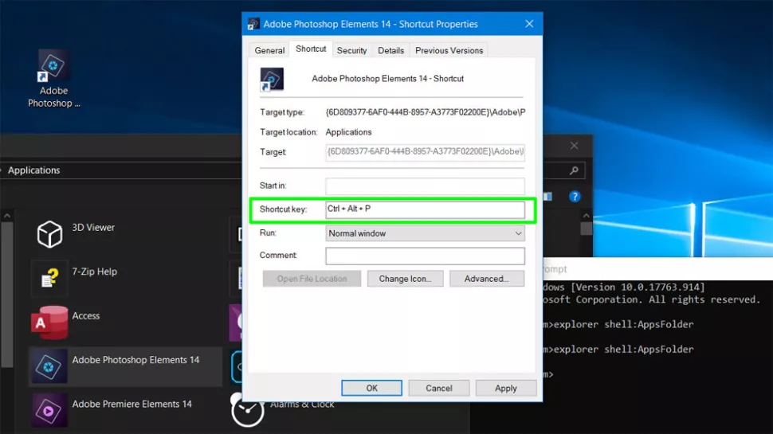
Windows 10 Settings to Change
Create Keyboard Shortcuts for Favorite Apps
Notes:
Every time you roll your pointer across the screen, launch the Start menu and click an icon to launch one of your favorite apps, you're wasting a little time.
If you create keyboard shortcuts for your favorite apps, you can launch them by hitting a single key combo such as CTRL + ALT + W to launch Microsoft word or CTRL + ALT + C for Chrome.
To create keyboard shortcuts, first open the command prompt (you can get there by searching for "command") and enter "explorer shell:AppsFolder" (without the quotes). A window with icons for all of your installed apps opens and you should then drag the app you want onto your desktop. Right click the desktop shortcut icon and select properties. Then enter a key combo, usually one that includes ALT + CTRL + LETTER, into the "Shortcut key" box and click Ok. Repeat for all your favorite apps.

Slide 9
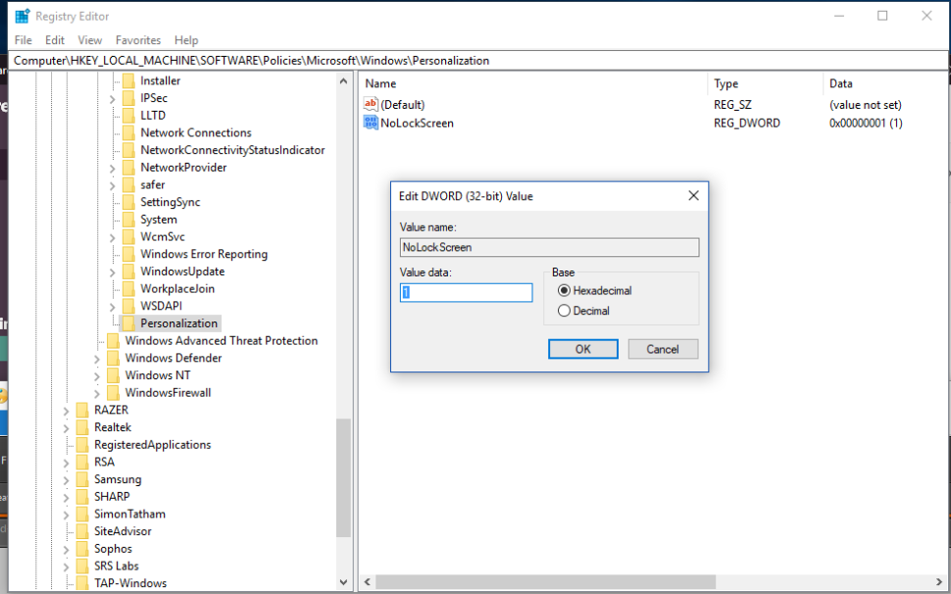
Windows 10 Settings to Change
Get Rid of the Useless Lock Screen
Notes:
When your computer is locked (or first boots), by default, Windows 10 shows you a lock screen with the time, a wallpaper and maybe (if you allow) some notifications. If you use Windows Hello facial or fingerprint recognition, you can log in by staring at the screen or putting one of your digits on the scanner. But, if you use a password, you have to click to dismiss the lock screen before the OS will allow you to enter your credentials.
That's one extra, unnecessary click every single time you want to unlock your PC. To get rid of the annoying lock screen and save your tired fingers, open the registry editor and navigate to HKEY_LOCAL_Machine\SOFTWARE\Policies\Microsoft\Windows and create a new key called Personalization if it doesn't already exist. Within the Personalization key, create a DWORD (32-bit) value called NoLockScreen and set it to 1.

Slide 10
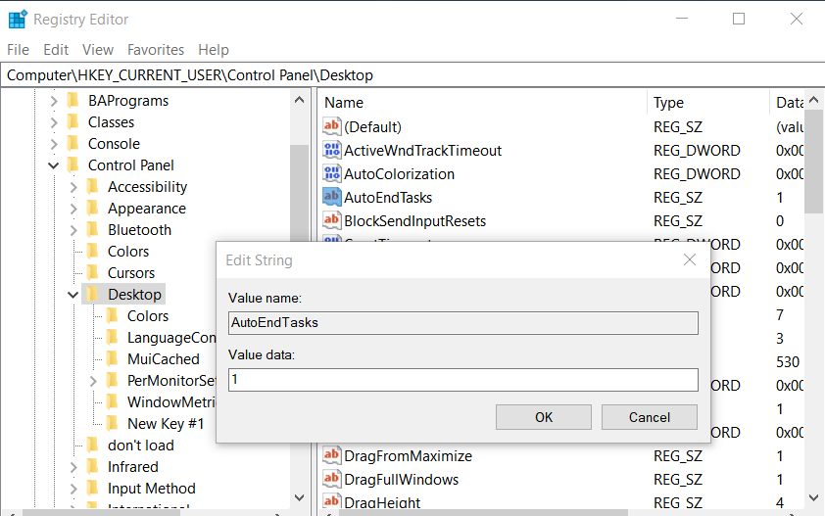
Windows 10 Settings to Change
Force Windows to Close Apps at Shutdown
Notes:
It's so annoying. You go to shutdown or restart your PC and you walk away, expecting your computer to be powered off (or rebooted) by the time you come back. You go to the fridge, grab a drink and return to find a message on your screen that says you have apps which aren't closed.
Maybe you just had a nearly-empty notepad doc or a picture in Photoshop that you didn't want to save because you already copied and pasted the data into another app. Now, Windows is nagging you to go back and close all your apps manually. Yes, Windows gives you a button that says "Shut down anyway," but you have to hit it and wait for the system to hopefully force close the apps.
The best solution is to open the registry editor, navigate to \HKEY_CURRENT_USER\Control Panel\Desktop and create three strings (if they don't already exist). Create AutoEndTasks and set it to 1, create WaitToKillAppTimeOut and set it to 2000. Finally, create HungAppTimeOut and set that to 2000 also. These automatically force-close any open apps after a 2000-millisecond (2 second) delay (shorter delays could be problematic because it wouldn't give apps that are closing time to close themselves).

Slide 11
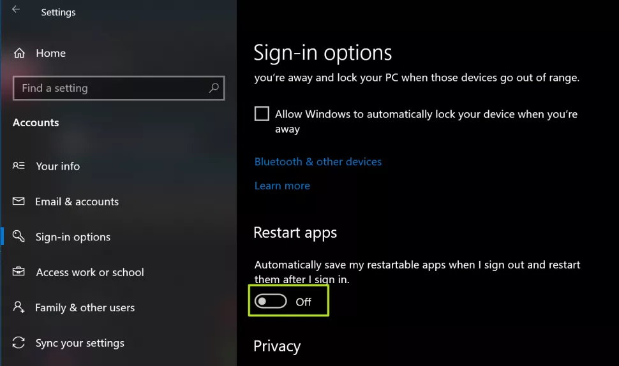
Windows 10 Settings to Change
Prevent Windows From Re-Opening Apps On Restart
Notes:
You have a ton of programs open -- so many that it's taxing your computer's system resources and causing lots of lag. You decide to restart your computer so to clear out the memory, but when you log in again, the OS opens all the same programs you had active before. Microsoft thinks it's doing you a favor by letting you pick up where you left off, but you'd be better off only re-opening the apps and tabs that you need right now.
To stop Windows 10 from automatically re-opening programs on reboot, navigate to Settings->Accounts->Sign-in Options and scroll down to the “Restart apps” subhead. Then turn the toggle to off for "Automatically save my restartable apps when I sign out and restart them after I sign in.”

Slide 12
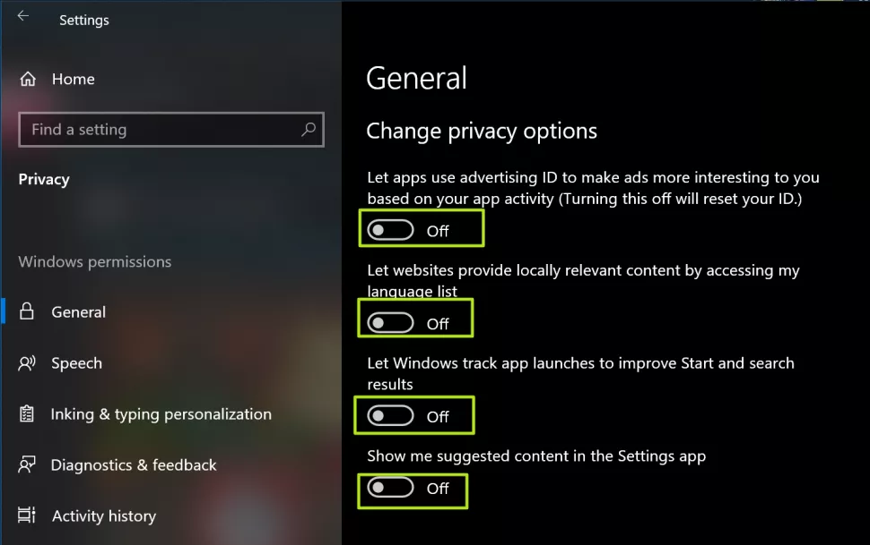
Windows 10 Settings to Change
Protect Your Privacy
Notes:
By default, Windows 10 shares a lot of data with Microsoft about your usage habits. Fortunately, by changing a few settings, you can keep at least some of your information out of the software giant's hands.
Navigate to Settings->Privacy and toggle all the settings to off.
These currently include four options: "Let apps use advertising ID, " "Let websites provide locally relevant content," "Let Windows track app launches" and "Show me suggested content."

Slide 13
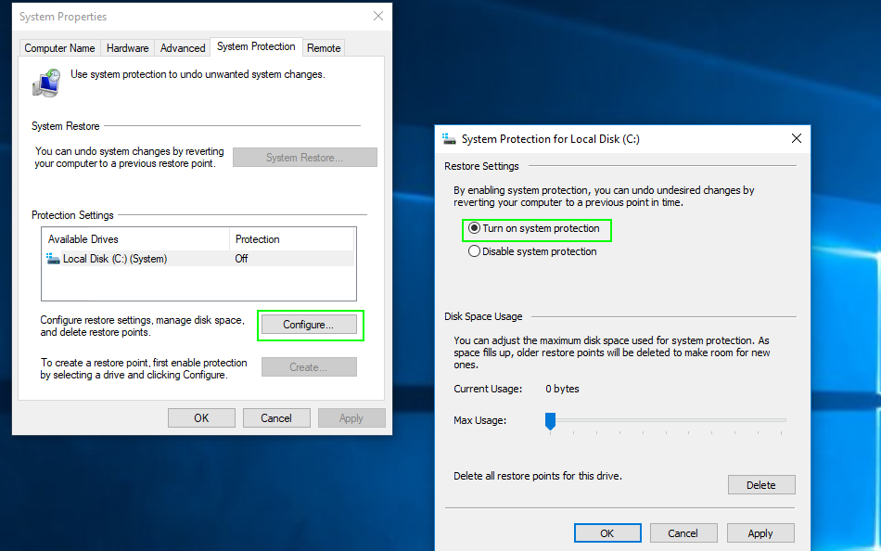
Windows 10 Settings to Change
Enable System Protection / Restore Points
Notes:
If something, like a bad driver, prevents Windows from booting or causes frequent blue screens of death, one likely solution is to return Windows 10 to its previous state. The best way to take a step back to a previous configuration (with the old driver or update or settings) is to do a system restore.
However, by default, System Protection, the feature which creates restore points you can return to, may be off. Turn on System Protection by typing "restore point" into the search box, clicking the top result, selecting your boot drive (usually C drive) , hitting the Configure button and then toggling "Turn on system protection" to on. We recommend setting maximum disk space usage to at least 5GB. Also you'll want to click the "Create" button to set up your first restore point.

Slide 14
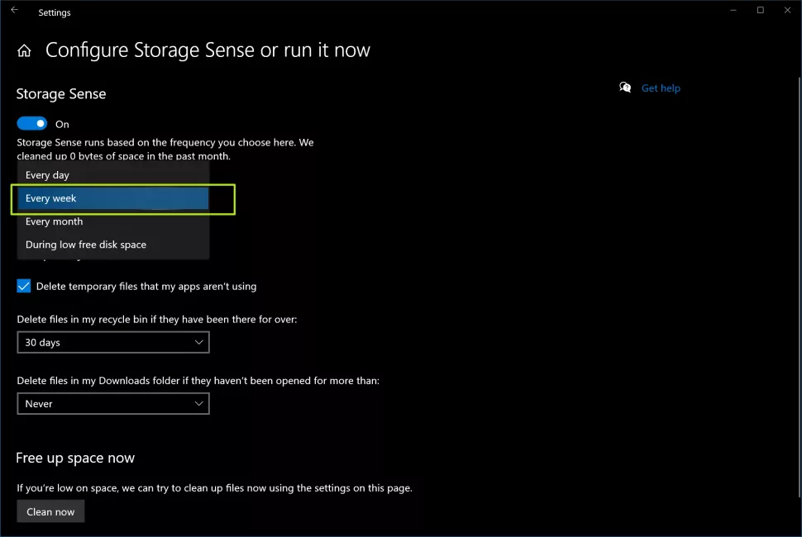
Windows 10 Settings to Change
Enable Storage Sense to Save Space
Notes:
Unless you have a 2TB SSD in your system, you can always use more free space. Windows 10 has an optional feature called Storage Sense, which automatically purges files you no longer need in order to free up precious gigabytes for you.
To enable Storage Sense, navigate to Settings->System->Storage and then click "Change how we free up space automatically." Toggle Storage Sense to On. Then click "Configure Storage Sense or run it now," set it to run every day and to delete files in your recycle bin and downloads folder every week (or every day if you want to be more aggressive).
After you've changed those settings hit the Clean Now button to free some space right away.

Slide 15
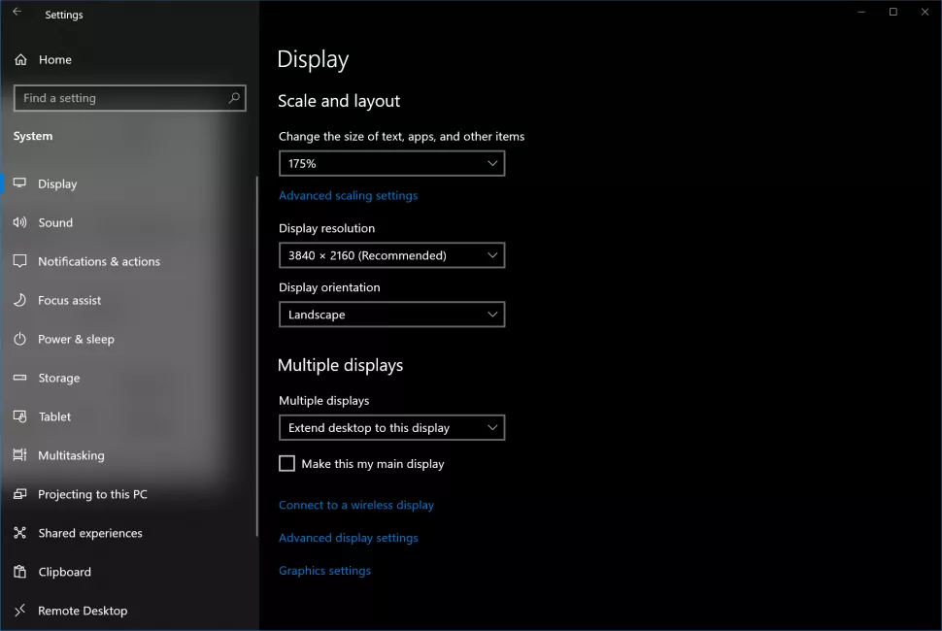
Windows 10 Settings to Change
Adjust Your Display Scaling
Notes:
Out of the box, Windows decides how large to make the text, icons and other widgets. A lot of the time, particularly on laptops, the operating system decides to operate at 150 percent or larger scaling, which makes it easier read but lets you fit less on the screen. Other times, the default scaling is too small as was the case with me and my 4K monitor, which felt most comfortable at 175 percent scaling.
To adjust the scaling to meet your personal preferences, navigate to Settings->System->Display and scroll down to the "Scale and layout" header. Then try different percentages until you find the one that works best for you. If you can see 100 percent scaling comfortably, that's ideal, because it provides the most screen real estate.

Slide 16
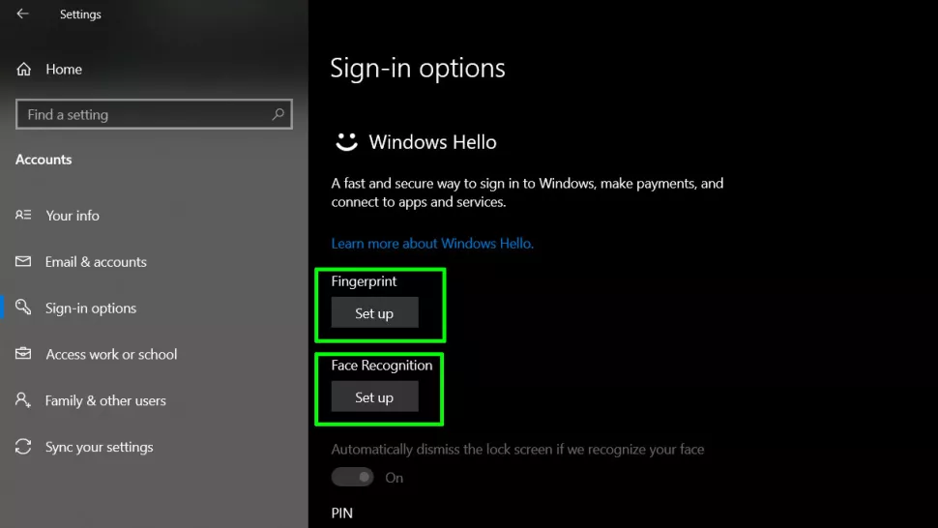
Windows 10 Settings to Change
Set Up Fingerprint or Facial Recognition
Notes:
Why waste time typing in a password when you can create log into Windows 10 with either a finger scan or facial recognition. If your computer has either a fingerprint reader or an IR camera, you can use the operating system's Windows Hello feature to unlock the computer, no typing required.
To set up Windows Hello, navigate to Settings->Accounts->Sign-in Options and click the Set up button under Fingerprint or Face Recognition. If you don't already have one, you'll be asked to create a PIN, which you can also use to log in and is faster to type than a password.

Slide 17
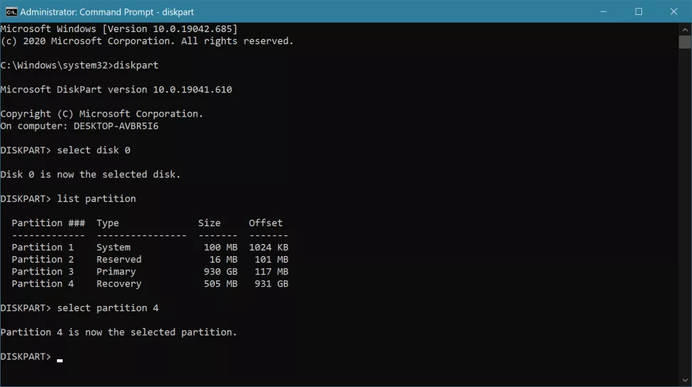
Windows 10 Settings to Change
Delete the OEM Recovery Partition to Save Space
Notes:
This is a somewhat controversial recommendation so consider your options. Most laptops and pre built desktops come with a recovery partition that eats up at least 20GB of disk space. The point of these recovery partitions is to enable you to get back to a factory state if your computer becomes unbootable. This factory state is not just a clean Windows 10, but one with all the drivers and preloaded software the computer came with. Usually, you can invoke these from some kind of emergency menu before boot.
However, there are many other ways to restore a crashed computer without sacrificing this disk space. First of all, you can always use an existing restore point or full system backup to get back to where you were right before the crash. If you don’t have a backup and need to start from scratch, you can create a Windows 10 install USB by downloading and using MIcrosoft’s own installation media tool. If you have a laptop or even most OEM desktops, your original Windows key will already be recorded in your BIOS. And, if you don’t have a key, you can always get Windows 10 for Free or Cheap.
Note: There is also a non-OEM recovery partition that is usually 1GB or less that makes Windows 10’s own factory reset feature function better and that’s probably worth leaving in place.
So, if you’re a reasonably tech-savvy user, you can safely delete the OEM recovery partition and save some GB. Unfortunately, you can’t do it by just using the standard partition manager. To remove the OEM restore partition, first see if you have one by looking at the partition manager (enter “partition” in the search box and click the first option). The name of the partition should have “OEM” or the name of the OEM (ex: HP, Dell, Lenovo) in it and “Recovery.” If you only have a non-OEM recovery partition, stop here.
To delete the partition, open a command prompt as admin by typing “cmd” into the search box and right clicking the right result and selecting “Run as administrator.” Then enter “diskpart” at the command prompt. Type “select disk 0” to choose your boot drive and then “list partition” to show all your partitions and then “select partition [NUMBER]” where the number is the recovery partition’s number. Finally, type “delete partition” and it should be gone. If you get an error, try entering “gpt attributes=0x8000000000000000” and then do it again.

Slide 18
Main Topics
Windows 10 Settings to Change
12 Simple Tweaks to Speed Up Windows 10
Windows 10 Free Fix Tools
Finding the old SYSTEM panel
Windows 10 Power Tools
Windows 10 on a Bootable USB
Windows 10 Registry Backups
The basis for all of these items came from various PC Magazine articles
Notes:
As PC hardware continues to speed up, so does software, and Windows 10 is no exception. This is especially true of startup time: If you upgrade from Windows 7 or earlier, you'll be pleasantly surprised by how fast your machine is ready for action. There are other performance factors to consider after you're up and running, however. Even the latest, shiniest Windows version isn't immune to slowdowns.
The problem with a lot of Windows speedup stories is that they tell you to turn off some of the operating system's more-fun features, such as visual animations. Most of these tips show you ways you can speed up your Windows 10 system without compromising its appearance and functionality. Most are also free, but some involve spending a little cash on software or hardware. For people with older, low-power machines who want a speed boost but don't care about extra goodies, a couple of the tips towards the end do boost system performance at the expense of visual bling.
Note that you should beware of those "Speed Up Your PC!" ads for registry cleaners, which often lead to malware. Microsoft categorically does not support the use of registry cleaners for Windows 10.
Something that is recommended is to keep your OS version up to date. This may seem too obvious to include below as a separate step. Periodically head to the Settings app's Windows Update section to see whether there are any security and reliability updates you should install. Your PC may run faster after one of these, since they also can include hardware driver updates. Do this even if you don't want yet want a big feature update—you can delay those major updates in the same section of Settings.

Slide 19
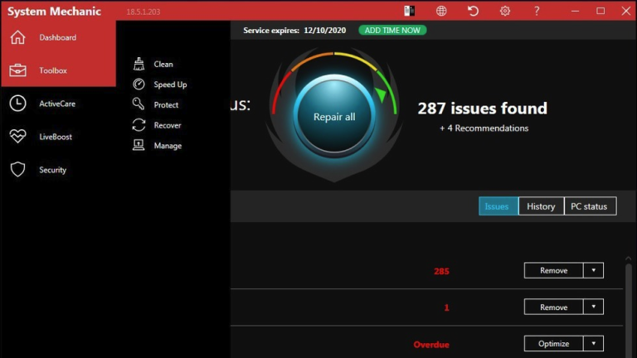
12 Simple Tweaks to Speed Up Windows 10
Run a Tune-Up Utility
Notes:
PCMag's Jeffrey Wilson has painstakingly evaluated the best third-party system speedup and cleanup utilities for Windows 10. He's found that most of them actually do boost PC performance, even if it's only a modest performance boost. Of course, there are plenty of malicious downloads out there claiming to speed up your PC, so be sure to stick with Wilson's list of tested products. Iolo System Mechanic ($24.95) does best in his testing, but others are worth a look for their range of features and price points.

Slide 20
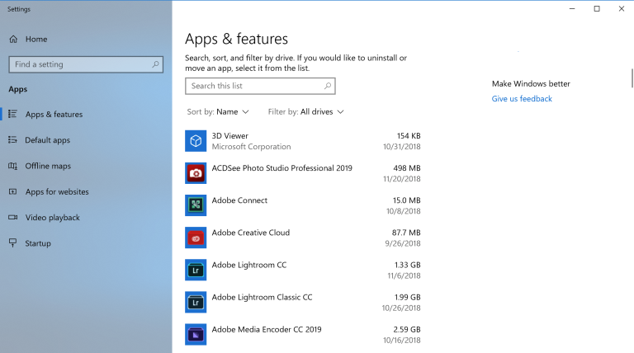
12 Simple Tweaks to Speed Up Windows 10
Uninstall Crapware
Notes:
We’ve been through this one already, so I’ll skip the details this time.

Slide 21
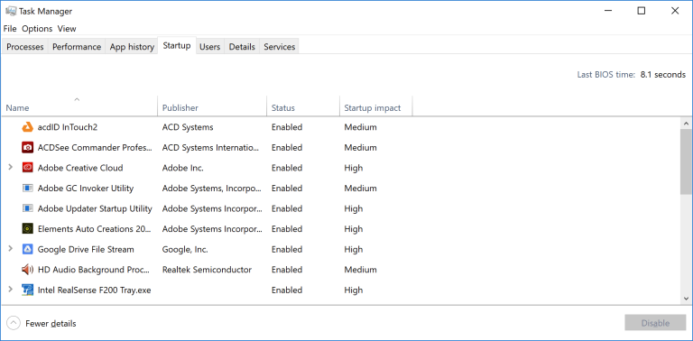
12 Simple Tweaks to Speed Up Windows 10
Limit Startup Processes
Notes:
As mentioned in the last entry, a lot of programs install side processes that run every time you start your PC, and some of them are not things you need running on your system all the time. Compared with Windows 7, in which you had to run the MSCONFIG utility, Windows 10 (and Windows 8.x before it) gives you an easier way to limit what runs at startup—from the updated Task Manager.
The easiest way to invoke the Task Manager is by pressing Ctrl-Shift-Esc. Switch to the Startup tab, and you'll see all the programs that load at Windows startup. The dialog box even has a column that shows you the Startup impact for each. The Status column shows whether the program is enabled to run at startup or not. You can right-click on any entry to change this status. It's usually fairly easy to see things you don't want to run. For example, if you never use iTunes, you probably don't need iTunesHelper running all the time.

Slide 22
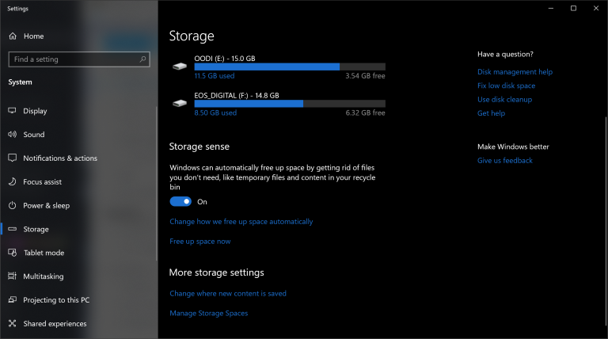
12 Simple Tweaks to Speed Up Windows 10
Clean Up Your Disk
Notes:
From the Start menu, type Disk Cleanup. This opens the trusty Disk Cleanup utility that's been part of Windows for several generations of the OS. Disk Cleanup finds unwanted junk such as temporary files, offline Web pages, and installer files on your PC and offers to delete them all at once. You may even find that your Recycle Bin is bulging at the seams. This will generally only have a noticeable effect on speed if your drive is getting close to full, however.
If you don't have disk defragmentation scheduled regularly, set that up in the Optimize Drives tool, which you can find by typing its name in the Cortana search box next to the Start button. Note that if your main disk is an SSD, then you needn't bother with defragging, since there aren't any moving parts reading the disk.
An even newer way to keep storage use is by enabling the Storage Sense option (see image above). This automatically frees up space by removing temporary files and Recycle Bin items. We spoke about this new feature a few slides ago, so we’ll skip repeating the details here.

Slide 23
12 Simple Tweaks to Speed Up Windows 10
Add More RAM
Notes:
Windows 10 manages memory more efficiently than earlier versions of the OS, but more memory always can potentially speed up PC operations. For a lot of today's Windows devices, such as the Surface Pro tablets, however, adding RAM isn't an option. Gaming and business laptops often still allow RAM upgrades, but that's becoming more rare. The new, slimmer ultrabooks and convertibles are usually fixed. If you still use a desktop tower, this article can show you how to add RAM. The bigger RAM makers' (Crucial, Kingston, Corsair) websites all offer product finders that show you which type of RAM your PC takes, and prices are pretty reasonable. You can get 8GB high-performance DDR4 RAM for about $60.
If that's still too much, and your computer is very old, has a hard drive rather than an SSD (see below), and has little RAM, you could try using ReadyBoost with a USB stick. This caches data on the portable storage device's storage to speed up memory access that would be slower with a spinning hard drive. Just go to the USB key's File Explorer entry, right-click to open Properties, and switch to the ReadyBoost tab to get going. For most up-to-date systems, this feature won't be available and would provide no performance boost.

Slide 24
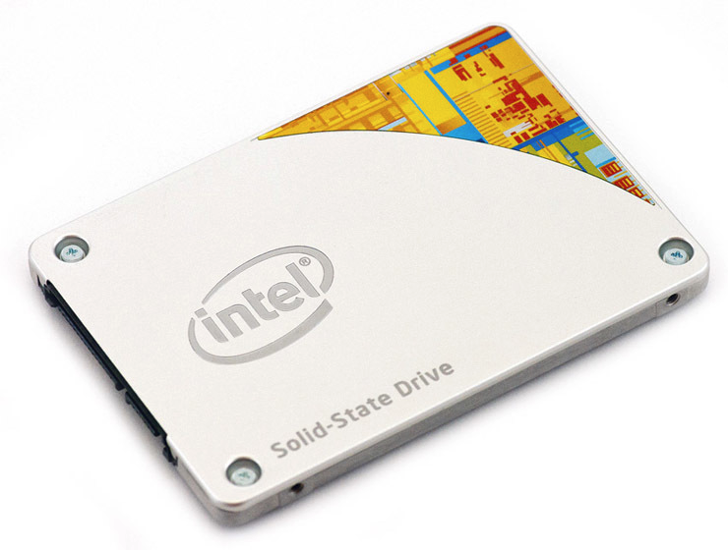
12 Simple Tweaks to Speed Up Windows 10
Install an SSD Startup Drive
Notes:
Not does Windows startup benefit, but loading and using demanding applications such as Adobe Photoshop happens much faster with an SSD. Windows Store apps can even easily be moved from a spinning hard drive to an SSD in Settings' Apps and Features page.
For system speedup, it makes sense to replace your internal startup hard drive, and if you use a laptop, this may also be an option. But an external SSD with a USB 3.0 connection can also give you a speed boost in applications that use a lot of storage.

Slide 25
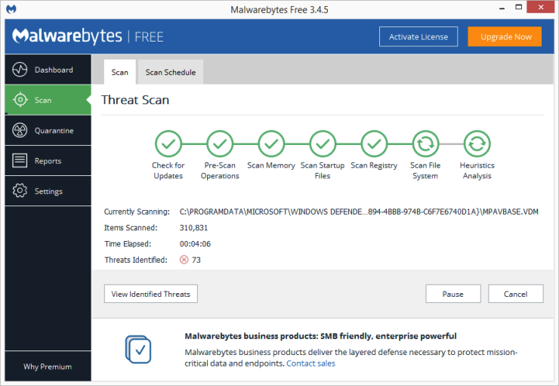
12 Simple Tweaks to Speed Up Windows 10
Check for Viruses and Spyware
Notes:
You can run the built-in Windows Defender or a third-party app to do this, but you're best served by PCMag security guru Neil Rubenking's top pick among malware-cleanup programs, Malwarebytes Anti-Malware—it's free! But don't forget to use ongoing anti-malware protection, too. Some of the AV products have a lighter footprint on system performance than others, and the lightest of all, according to Rubenking, is Webroot SecureAnywhere AntiVirus. Rubenking also awards 4.5-star-rated Editor's Choices to Bitdefender's and Kaspersky's AV software. See his complete roundup of the best antivirus software for full details.

Slide 26
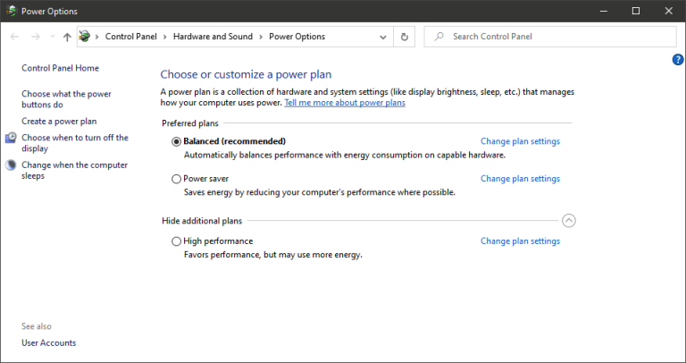
12 Simple Tweaks to Speed Up Windows 10
Change Power Settings to High Performance to Optimize Speed
Notes:
Of course, this isn't a good choice if you want to save electricity, but it could boost your PC's computing speed. Head to the Settings app's System > Power & sleep option and then click the Additional power settings link. From here, click the dropdown arrow on the right side to "Show additional plans" and then choose High Performance.

Slide 27
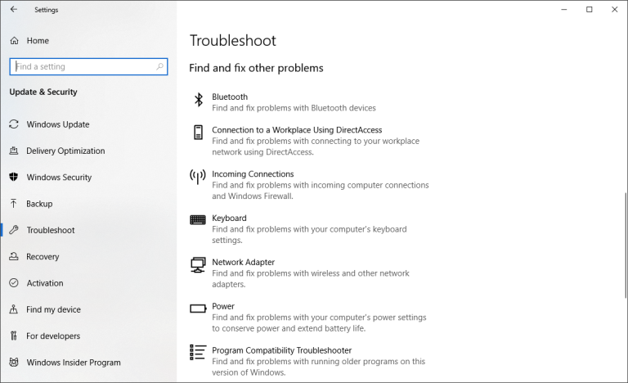
12 Simple Tweaks to Speed Up Windows 10
Run Troubleshooters
Notes:
Open the Settings app and search for troubleshoot. Windows recommends troubleshooting utilities you should run, and you can choose to run them automatically or manually. For good measure, run the other troubleshooters, including Search and Indexing, Hardware and Devices, and Windows Store Apps. Also go to the old-style Control Panel's System and visit Security > Security and Maintenance page (or just type maintenance in the Start menu search box), click Maintenance, and hit Start Maintenance. This happens automatically on a daily schedule (you can change the time it runs—mine was set for 2 a.m.), but if you're experiencing slowdowns, it's worth trying.
If your PC is still hopelessly bogged down, you can use the Windows Security app's Fresh start option, but be warned that doing so may remove some of your installed programs, but your personal files are kept.

Slide 28
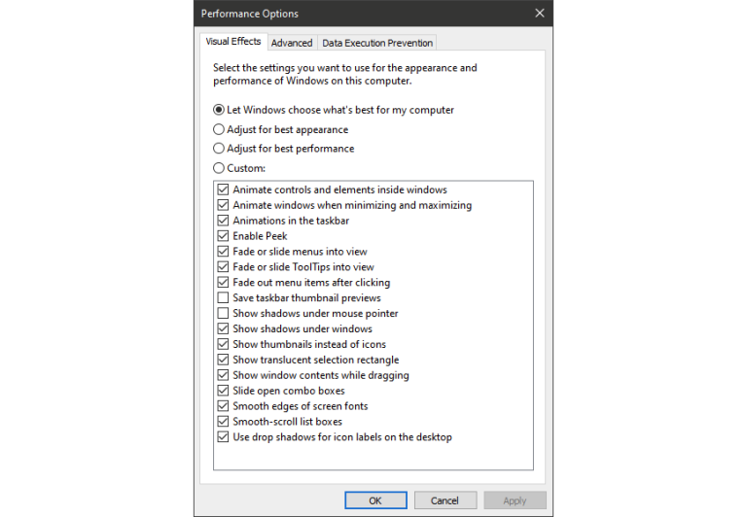
12 Simple Tweaks to Speed Up Windows 10
Change Appearance in Performance Options
Notes:
You can easily get to this setting by typing adjust appearance in the Start menu's search box. In the dialog, you can use the radio button at the top labeled Adjust for best performance or select which eye-candy features you can live without from the long list of check boxes below these choices. If you choose the overall best-performance button, you'll lose all of the visual effects. For example, you won't see the contents of a window you're dragging move, but rather just a rectangle representing the window's edges. Keeping the effects that you enjoy checked in the dialog is probably a better way to go. You can also get to this tool from the new Settings app and searching for "maintenance" or "performance."

Slide 29
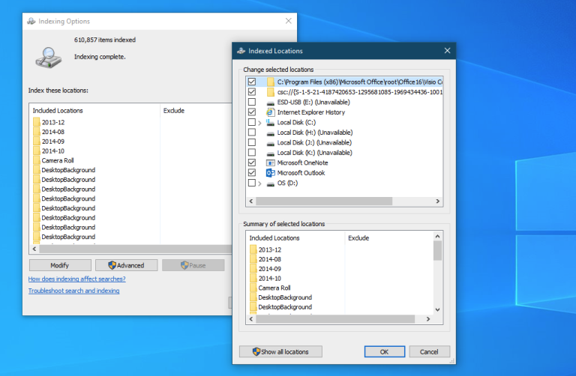
12 Simple Tweaks to Speed Up Windows 10
Turn Off Search Indexing
Notes:
Especially for lower-powered PCs, search indexing can eat up system resources, if only temporarily. If you do a lot of searching, this won't appeal to you, as some searches will be slower. To turn off indexing, open the Indexing Options Control Panel window (you can also just type index in the Start button search box to see Indexing Options at the top of the result list). Click Modify and uncheck locations you don't want indexed. Choosing Advanced lets you decide which file types should and shouldn't be indexed.
If you leave search indexing on but find that it occasionally slows down your PC, you can stop its process when you need extra speed. Right-click This PC on the desktop (or type Computer in the Search box), and choose Manage. Then, double-click Services and Applications, and select Services.
Find Windows Search, and double-click on that. From this Properties dialog, you can choose a Startup type of Manual or Disabled to have the process silent by default. The Automatic (Delayed Start) startup type according to Microsoft help, "is preferred over the Automatic startup type because it helps reduce the effect on the system's overall boot performance." That may be turned on by default.
A final option is to go to the right-hand panel, click More options, and then Stop. You can also simply hit the stop button above the center section. Don't forget to turn it back on at some point if you want to be able to search your system.

Slide 30
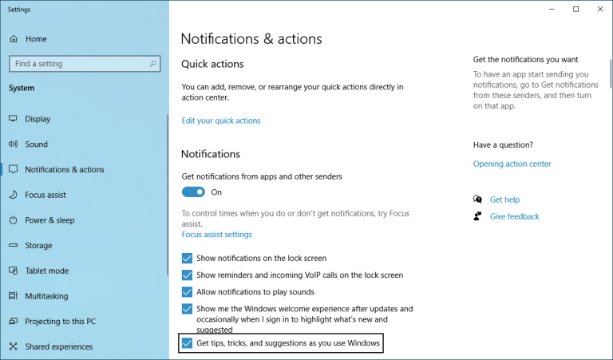
12 Simple Tweaks to Speed Up Windows 10
Turn Off Tips and Notifications
Notes:
It may seem odd for a tips article to tell you to turn off Windows 10's Tips feature, but it can reduce processing that Windows needs to do to display relevant tips for your system. The same can be said for Notifications. If Windows doesn't need to generate a notification, your computing will go faster. I have over 40 apps that are capable of sending notifications. Simply open the Settings app's Notifications & actions page to change the notification settings. You'll see a list of individual apps that can send notifications, and you can uncheck those you don't want to hear from. If you have a lot of these, too, go through the list and you're bound to find sources from which you have no need to be notified. The distraction savings alone can speed up your PC use, if only in terms of your perception of computing speed. An easy way to pause notifications is to tap the Focus Assist button in the Action Center. This also makes it easier to re-enable them later.

Slide 31
Main Topics
Windows 10 Settings to Change
12 Simple Tweaks to Speed Up Windows 10
Windows 10 Free Fix Tools
Finding the old SYSTEM panel
Windows 10 Power Tools
Windows 10 on a Bootable USB
Windows 10 Registry Backups
The basis for all of these items came from various PC Magazine articles

Slide 32
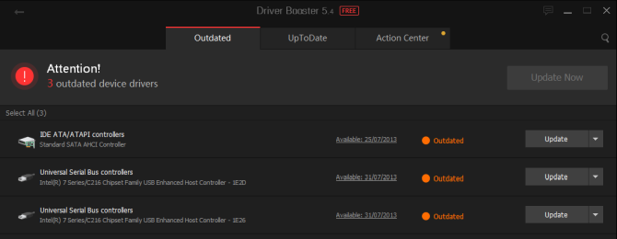
Windows 10 Free Fix Tools
IOBit Driver Booster
http://macbooster.7eer.net/c/119570/342156/4385
Notes:
Windows 10 tries to handle driver updates, but it isn't perfect. Sometimes it'll leave some essential driver updates behind. So, when a hardware issue strikes, it's always worth checking if you need to update your drivers.
One of the best ways to check the status of your Windows drivers is using a free driver update tool, and IOBit Driver Booster is one of the best Windows 10 driver update tools, claiming to fix and update over 1,000,000 drivers.
Download and install Driver Booster, making sure to deselect any additional software offered to you.
Open Driver Booster. You'll spot three tabs: Outdated, UpToDate, and Action Center. The first two are fairly self-explanatory, containing the lists of your system drivers and their status. The Action Center tab contains download links for other IOBit utilities.
Select the Outdated tab. You can choose to Update Now using the big red button, or head down the list and update individual drivers as you see fit. You can also choose to ignore specific drivers, roll them back to their previous state, or uninstall them entirely. Driver Booster automatically downloads and applies the drivers to your system, but you may require a system reboot to finish the installation process.
Driver Booster creates a system restore point before updating your drivers, as well as including options for automatic shut down or reboot after the driver installation process completes---handy for leaving the tool running just before bed!

Slide 33
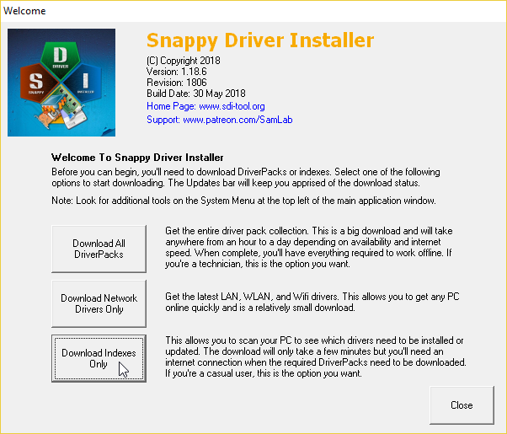
Windows 10 Free Fix Tools
https://sdi-tool.org/
Alternative: Snappy Driver Installer
Notes:
Snappy Driver Installer (SDI) is a free and open source driver updater with a vast driver collection for offline use. Microsoft keeps Windows 10 up-to-date, but sometimes your drivers get left behind---and outdated drivers can often cause weird issues.
Head to the Snappy Driver Installer download page. Download and unzip the SDI Lite version, then run the SDI application. Select Download Indexes Only to let SDI to quickly scan your computer to see which drivers need updating or installing (and then marvel at the "grass" theme, and change it if you see fit!).
After SDI scans your system, it offers a list of potential new drivers. Head down the list and select the drivers you want to install (or click Select all in the left-hand option menu), make sure to select Create a new restore point, then select Install. The download and update process can take a while depending on how many drivers need updating.
Once the download and installation process completes, restart your system.

Slide 34
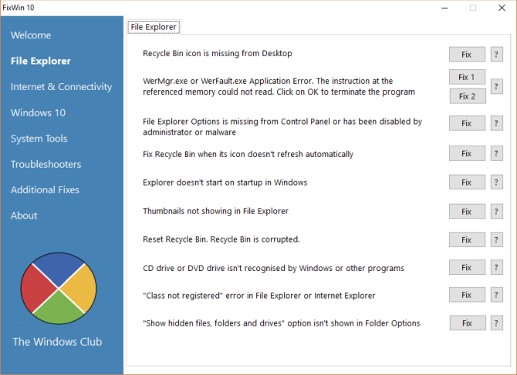
Windows 10 Free Fix Tools
FixWin 10
http://www.thewindowsclub.com/fixwin-for-windows-10
Notes:
FixWin 10 isn't just one of the best Windows 10 repair tools, it's portable! You can use FixWin 10 to repair a huge variety of operating system issues.
The program is divided into six neat sections, each representing problems with a specific component (File Explorer, System Tools, etc.). Each section contains at least ten fixes (see the full list here). Some of the fixes may require a reboot, but you'll be informed of this when you click the Fix button.
Fixes vary from common irritants, such as the Recycle Bin icon failing to automatically update after emptying, to more advanced fixes like restoring access to the Registry Editor.
The Additional Fixes section contains novel-but-useful tweaks, such as restoring the Sticky Notes delete warning dialog box, while the Troubleshooters section directs you to the relevant Windows 10 troubleshooter tool on your system. The integrated troubleshooters are sometimes the easiest option, at least before delving into the depths of your system.

Slide 35
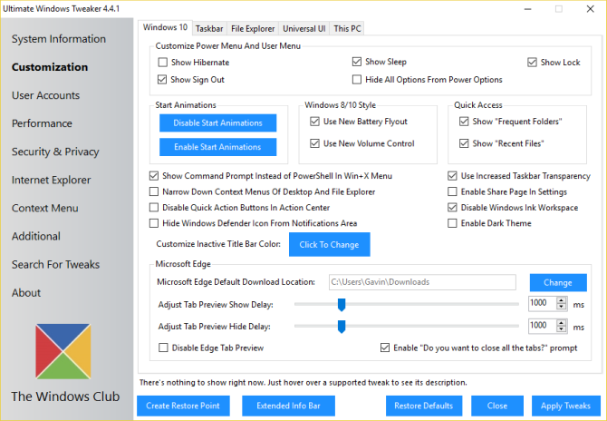
Windows 10 Free Fix Tools
http://www.thewindowsclub.com/ultimate-windows-tweaker-4-windows-10
Ultimate Windows Tweaker 4
Notes:
Ultimate Windows Tweaker has the same developer as FixWin10 (The Windows Club). This is immediately evident because both programs share the same easy-to-use interface.
Unlike FixWin 10, which addresses Windows 10 issues and lets you fix them, this program enables you to quickly enable, disable, hide, or remove specific features from Windows.
You can make each change listed in this program using the Windows 10 Settings app, the Registry Editor, or the Group Policy Editor. However, Ultimate Windows Tweaker puts all the options within neat sections that list relevant issues which you can then address quickly.
Click the Create Restore Point button at the bottom left before you start, tick the changes you want to make, then click Apply at the bottom. The Additional section lets you bring back Windows 7's Windows Photo Viewer with one click.
There are over 200 Windows 10 tweaks that are available at the click of a button. Making changes to your OS has never been easier.

Slide 36
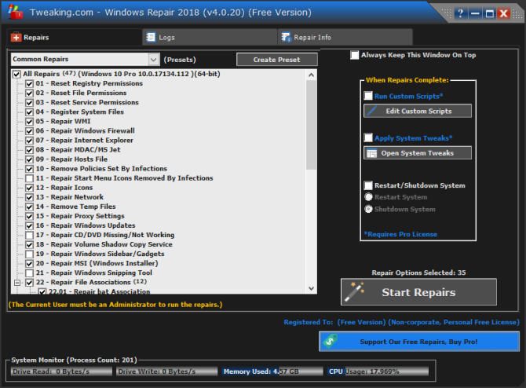
Windows 10 Free Fix Tools
Windows Repair
https://www.bleepingcomputer.com/download/windows-repair-all-in-one/
Notes:
Windows Repair (All in One) is another free and useful Windows 10 repair tool you can use to repair numerous Windows 10 issues. The Windows Repair developer strongly suggests you should run the tool in Safe Mode for maximum effect. (How to boot into Windows 10 Safe Mode?) The Windows Repair tool has its own Reboot to Safe Mode button for a quick reboot.
The repairs cover registry permissions, file permissions, Windows Firewall settings, Winsock and DNS cache fixes, Windows Update issues, and much more. The Windows Repair tool guides you through a fix process that automates the Windows Check Disk (chkdsk) and System File Checker (sfc) utilities.
If the utilities don't fix your issues---and you know what you're doing and understand the risks---you can head to the Repairs tab. Here you have six options. The Open Repairs button opens the repair panel containing the numerous fixes available. The other options are preset to fix specific issues, such as malware cleanup, broken file permissions, and Windows Updates.

Slide 37
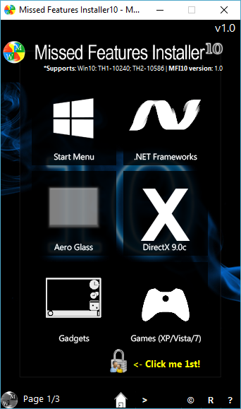
Windows 10 Free Fix Tools
Missed Features Installer
http://www.chip.de/downloads/Missed-Features-Installer-fuer-Windows-10_88552123.html
Notes:
Windows 10 is a great operating system, and despite some well-documented irritations, most users seem to enjoy using it.
However, not everyone was happy when Microsoft made the jump from Windows 8.1 to Windows 10 (or Windows 7 to Windows 8.1, as evidenced by Windows 7 still being used on nearly 40 percent of computers worldwide even one year before Microsoft ends all support for it).
The main gripes? Features that didn't make the cut for the arrival of Windows 10. Luckily, the Missing Features Installer brings back many of those popular old features in one handy download.
For instance, do you hate the Windows 10 Start menu? You can use the Missed Features Installer to switch to Classic Start Menu. Miss the legendary 3D Pinball for Windows? Who in their right mind doesn't! Install classic games from Windows XP, Vista, and 7 with this tool.
The utility also has options for disabling Windows Update (though I'm not sure how well that works, and besides, you should keep your system up to date), and removing the Microsoft Edge browser, Cortana, and the integrated Windows Telemetry. However, these features are experimental and could damage your system so make sure to set a system restore point before diving in.

Slide 38
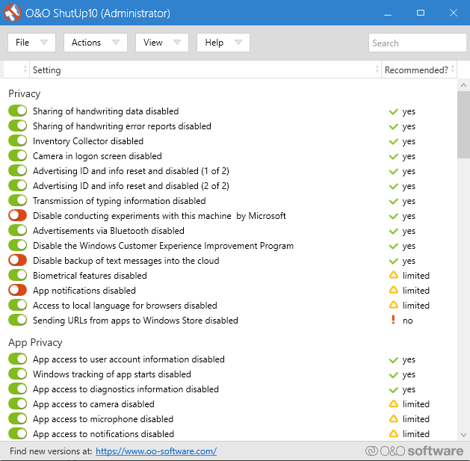
Windows 10 Free Fix Tools
O&O ShutUp10
https://www.oo-software.com/en/shutup10
Notes:
Windows 10 has privacy issues, and Microsoft knows it. Windows 10 privacy control has improved slightly since its 2015 release, but the core issues of tracking, telemetry, and data gathering remain.
While some users believe this is a necessary evil for the operating system development to continue with lashings of user-data, you don't have to give up your data. Several tools curtail Microsoft and Windows 10 data gathering tendencies and O&O ShutUp10 is one of them.
The program has nine sections offering various privacy settings, many of which are not directly available in the operating system. ShutUp10 makes turning off the unseen options as simple as flicking the numerous switches.
Most importantly, each option comes with a short description so you know what you're turning off and what functionality it might affect. Unfortunately, there are some downsides to turning everything off, so move slowly and check each option out.
O&O ShutUp10 has a handy Apply only recommended settings option, as well as the Recommended and somewhat recommended settings option that goes even further.

Slide 39
Main Topics
Windows 10 Settings to Change
12 Simple Tweaks to Speed Up Windows 10
Windows 10 Free Fix Tools
Finding the old SYSTEM panel
Windows 10 Power Tools
Windows 10 on a Bootable USB
Windows 10 Registry Backups
The basis for all of these items came from various PC Magazine articles

Slide 40
Finding the old SYSTEM panel
The SYSTEM panel went away when we installed the 20H2 Update
This was covered in the November 16th CAMUG presentation on Windows 10 20H2 changes
The previous SYSTEM items are mostly available in Settings / System
Some folks are reluctant to change, and want the old panel back
But, I have recently been informed that the old SYSTEM panel still exists – if you know where to look
So, let’s look at how to find it (as with many Windows functions, there are 3 ways!)

Slide 41
Finding the old SYSTEM panel
Through the old Control Panel
Type Control Panel in the Search window of the taskbar
Don’t click on System – this will only bring up the new Settings / System / About panel
Instead, drag the System link to your taskbar This should pin the System link to your taskbar
Right-click on it, then click on System
The old SYSTEM panel will now appear

Slide 42
Finding the old SYSTEM panel
Through the old Control Panel
Type Control Panel in the Search window of the taskbar
Right-click on System
Left-click on Open You have to click on Open, and not Open in New Window
The old SYSTEM panel will now appear

Slide 43
Finding the old SYSTEM panel
Through the old Control Panel
Open File Explorer
Click on This PC in the leftmost sidebar
Then right-click anywhere in the main window that isn’t overtop an icon
Left-click on Properties
The old SYSTEM panel will now appear

Slide 44
Finding the old SYSTEM panel
Of course, once Microsoft gets word of this, they might close this down
Or at least point these all to the new Settings / System panel

