Slide 1
Off Topic - Ransomware
Found email in my SPAM Folder
Subject was my OLD PASSWORD
I used to use one for everything back in the day
They are requesting BitCoin payment
Not to notify all of my contacts of Browser History
Their problem –
Every site already has different password (I think?)
I don’t care who knows my browser history
But I will be changing all of my passwords again.

Slide 2
Video Streaming Basics
March 2021

Slide 3
Traditional TV
Antenna capture OTA Broadcasts
Free (via Outdoor or Indoor Antennas)
Still there (and more than ever)
Stations have sub channels
3, 3.1, 3.2, 3.3, 3.4
5, 5.1, 5.2, 5.3
NBC, ABC, FOX, CBS and more
My Louisville, OH TV sees 55 channels

Slide 4
Connecting your TV to Content
Antenna (typically via Coax Cable screw on)
TV’s have other connections
Referred to as Inputs or Sources that you choose
Antenna
HDMI 1
HDMI 2
HDMI 3
Smart TV Functions
Ethernet

Slide 5
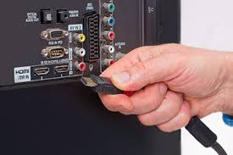
Source/Input Connections (Lots of Choices)

Slide 6
Inputs or Sources (Terms Used Interchangeably)
How You Select the “Receiving” Hardware
Antenna – Coax Connected typically
HDMI 1 - Roku Device (Internet Required, Wifi or Ethernet)
HDMI 2 - FireTV Device (Internet Required, Wifi or Ethernet)
HDMI 3 – AppleTV, Xbox, Chromecast (Internet Required)
Smart TV Functions - Built-in, Roku? (Internet Required)
RCA Type (Red, White, Yellow Wires)
Other VGA, Audio, etc.
HDMI Ports are interchangeable, it doesn’t matter what device goes on what HDMI Port, and on some TV’s you can name them for easier selection.

Slide 7
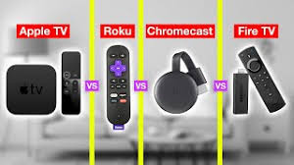
Hardware connected to Inputs/Source
Many looks, sizes, versions, and prices within each brand

Slide 8
Receiving Hardware Apps (Applications)
Antenna – Coax Connected, Receives Channels
HDMI 1 - ROKU Device
Instead of Channels has Apps (Names not Numbers)
Delivered with some Applications already installed
Via Store can add additional Applications (or delete existing)
Some Applications are Free (offerings vary)
The better Applications have a monthly fee that varies.
HDMI 2 - FireTV Device
HDMI 3 – Chromecast
Smart TV Functions Built-in
Ethernet - Wired to Router

Slide 9
Apps Connect to Service Providers Just like Apps on your Smart Phone
Roku Apps (or FireTV, or Chromecast, AppleTV, etc)
Hulu App
PlayStationVUE App
Philo App
Netflix App
Spectrum App
AT&T TV App
SlingTV App
YouTube App
YouTubeTV App
Disney+ App
Etc. many, many, many more each day
Haven’t seen a GOOD Browser App

Slide 10
Apps via Roku/FireTV/Other Input

Slide 11
Hardware Apps/Services You Need Hardware to Load to Apps/Services
Hardware | Apps/Services
Smart TV’s (VISIO, Samsung, Toshiba, etc.) | Sling TV
Roku (Roku TV, Roku Premium, Roku Stick) | Hulu
Chromecast (Cast from phone to TV) | Playstation VUE
FireTV (FireTV Lite, FireTV Stick, Recast) | YouTubeTV
AppleTV | Philo
WD TV Live (Hard Drive connection) | Spectrum Streaming (No Spectrum Box)
Etc. … | Premium Services Netflix Amazon Prime Video HBO Showtime ESPN Etc. …

Slide 12
Applications Have Unique Service Offerings
Prices vary, Prices change, (Usually No Conracts)
Programming varies (Live TV? Hallmark? History? Big10?)
Reduced Advertising? (i.e. YouTube Premium)
Multiple Sessions?, Away from Home?, Video Recording
Trial Period? Black Friday or Prime Day Specials
Application Combo (ESPN App if subscribed to YouTubeTV)
Might want more than one App/Service for your needs.

Slide 13
Spectrum Requires Cablebox on ALL TV’s
Why? To provide you better service! (but really to stop people from stealing cable) They are scrambling all of the channels.
Initially they will give you boxes for free (for the first year) then for monthly fee.
What they don’t tell you is you do not need their boxes (Must have 1 box in your house)
Avoid addt’l fees via Roku + Spectrum TV App

Slide 14
Traditional TV
Over The Air Antenna
New digital antenna’s (Clearstream, etc.)
Cable TV/Internet Providers
Spectrum
Massillon Cable
Satellite Internet (Data Caps?)
4G/5G Cellular (Data Caps)
Coming SpaceX and Amazon Satellite offerings

Slide 15
My Home
Clearstream Antenna Louisville OH (Free)
YouTubeTV (6 logins, 3 active, unlimited DVR, Live TV $70 mo.)
Philo (to get Hallmark $17 mo.)
Hulu (Black Friday $2 mo. for 1 year)
Amazon Prime ($10 mo. or free with Prime)
YouTube Premium ($13 mo. includes Music)
TOTAL $112 mo. (Divided 6 Families < $19 mo)

Slide 16
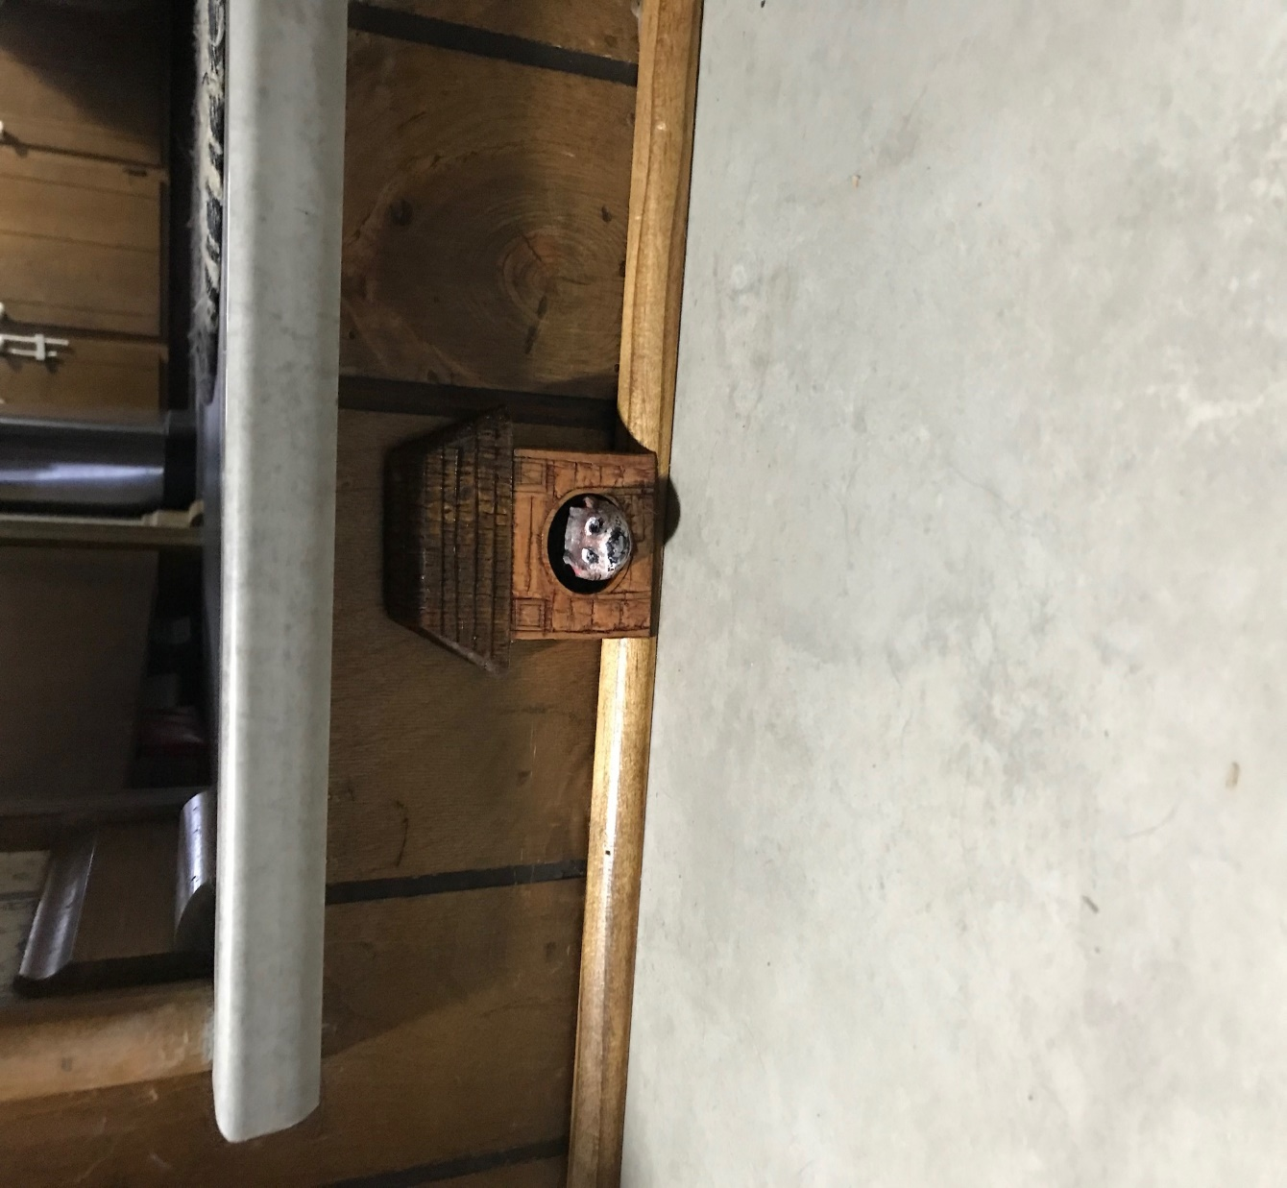
Ethernet vs WiFi

Slide 17
Discussion and Demos
Dennis, Bruce, Others
Do you want to see one live?
Philo Demo

